Slide 1
Computer Science Project
Character Creator/Designer
By Alex Sholla

Slide 2
Motivation
The goal of the project was to make a customizable character
Problems it solves: It is a good time killer to play around with for different combinations
It lets you design a hypothetical character for any adventure/roleplaying a person may do.

Slide 3
Aspects of the Program
Allows user to Name their character and change their title to a randomized one of 4 total titles
Enables people to customize the outfits, skin tones and hairstyle/color of their character.
Receive character codes and send character code options in order to re-create their character or save a character that they liked.

Slide 4
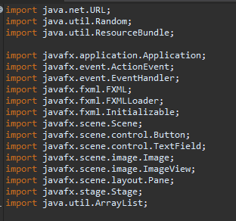
Tools used
Java FX
Scenebuilder
Aseprite

Slide 5
Demo!

